Slide 1


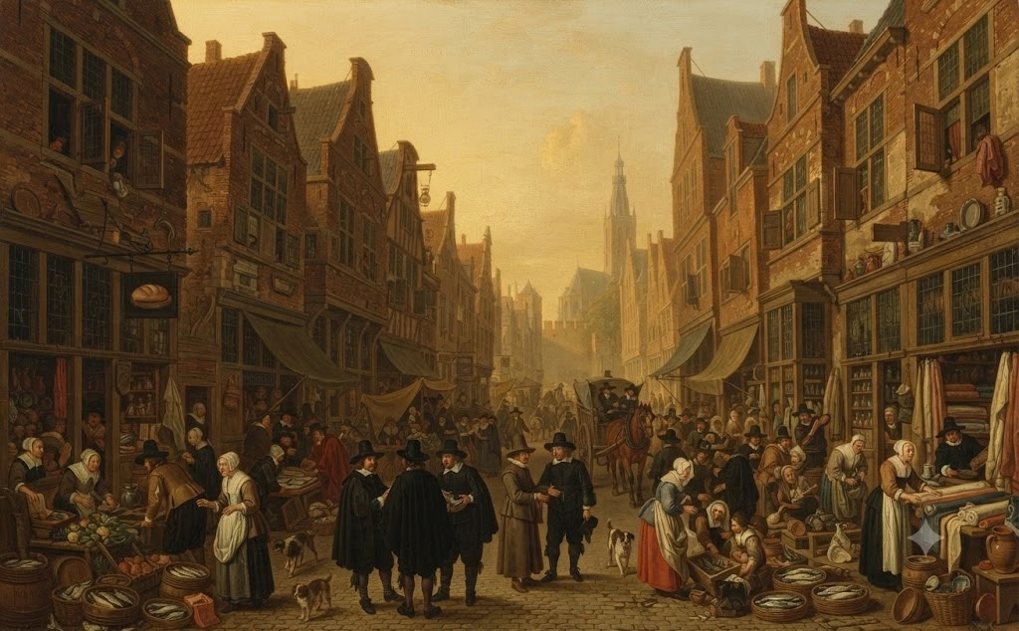
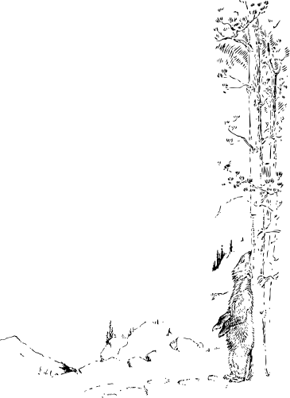


CREDIT ACCESS AND FINANCIAL INCLUSION: AN EMPIRICAL STUDY OF INDIAN MSME’S

Slide 2
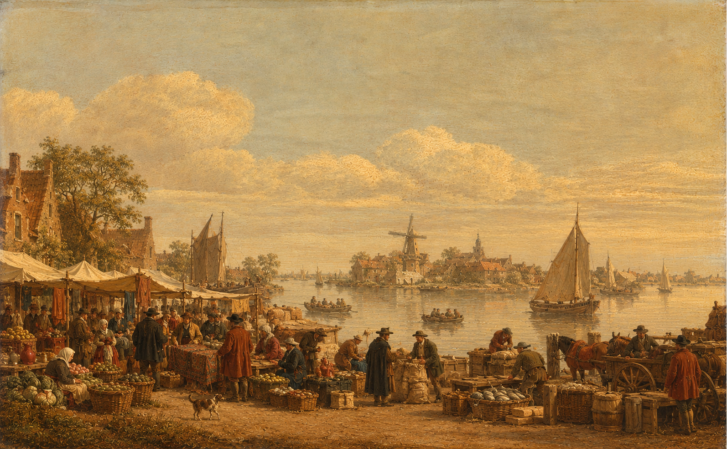


MSME
Presented by
Radhin Krishna
Haripriya
Credit Gap

Slide 3
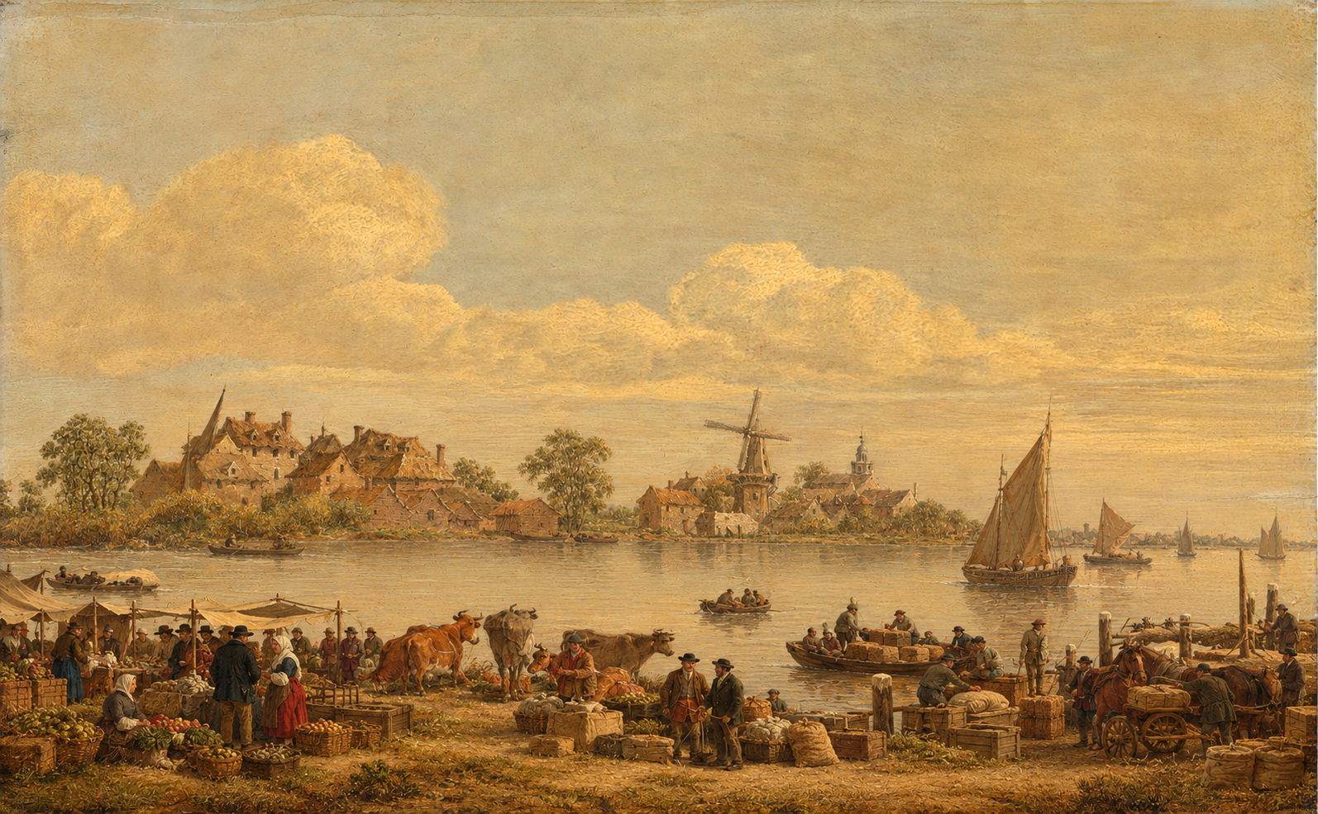
Businesses commonly require credit to:
  Start or expand their operations
  Purchase machinery, equipment and assets
  Buy raw materials and inventory
  Pay wages, rent and other operating expenses
  Manage temporary cash-flow shortages
  Take advantage of new business opportunities
What is Credit

Slide 4
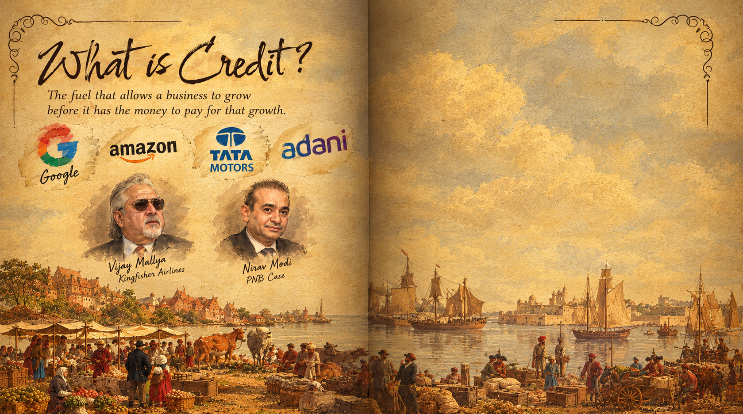
Google / Alphabet — $49.1B debt
Amazon — $68.8B debt
Tata Motors — ₹40,217 Cr borrowings
Adani Power — ₹47,254 Cr debt
Some Debt went wrong too
Vijay Mallya — Kingfisher Airlines
₹8,752 Cr still recoverable from the SBI-led consortium.
Nirav Modi — PNB Case
Involved in the PNB banking fraud, involving thousands of crores.

Slide 5
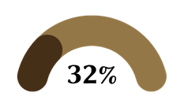
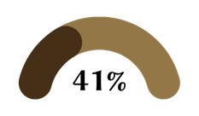
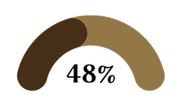

Indian
Msme
GDP Contribution
Forgein Exports
Manufacturing Output
63 Million Employees

Slide 6
problem
&
Approach
PROBLEM
As per niti ayog Repeot there is credit gap 330 Billion in MSME , even with profits every year MSME are not getting the loans they are deserving
OUR APPROACH
We went through SIDBI, MSME pulse, MSME minsitry reports and conducted a case study.
Conducted a feild survey participated by more than 40 msme owners regarding the issue severity, effectivness of government schemes

Slide 7

What Already happened
NITI AYOG RPEORT
2021
GOVERNEMENT SCHEMES, OCEN
2021-2026
Fin tech revolution
IMPACT REPORT
MSME pulse

Slide 8
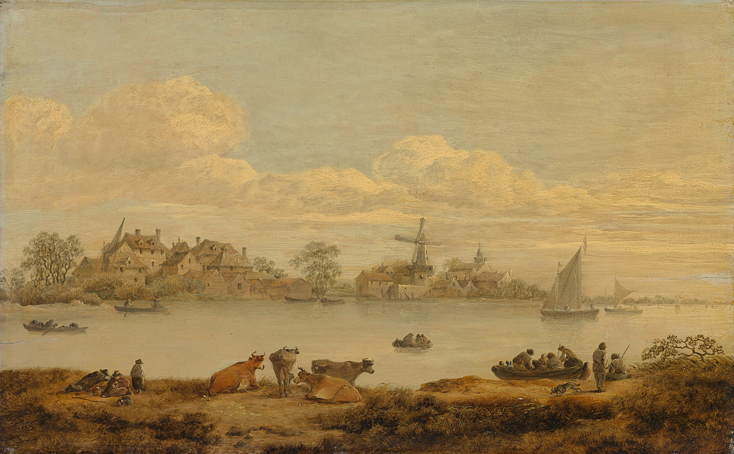
RESULTS
& Findings

Slide 9
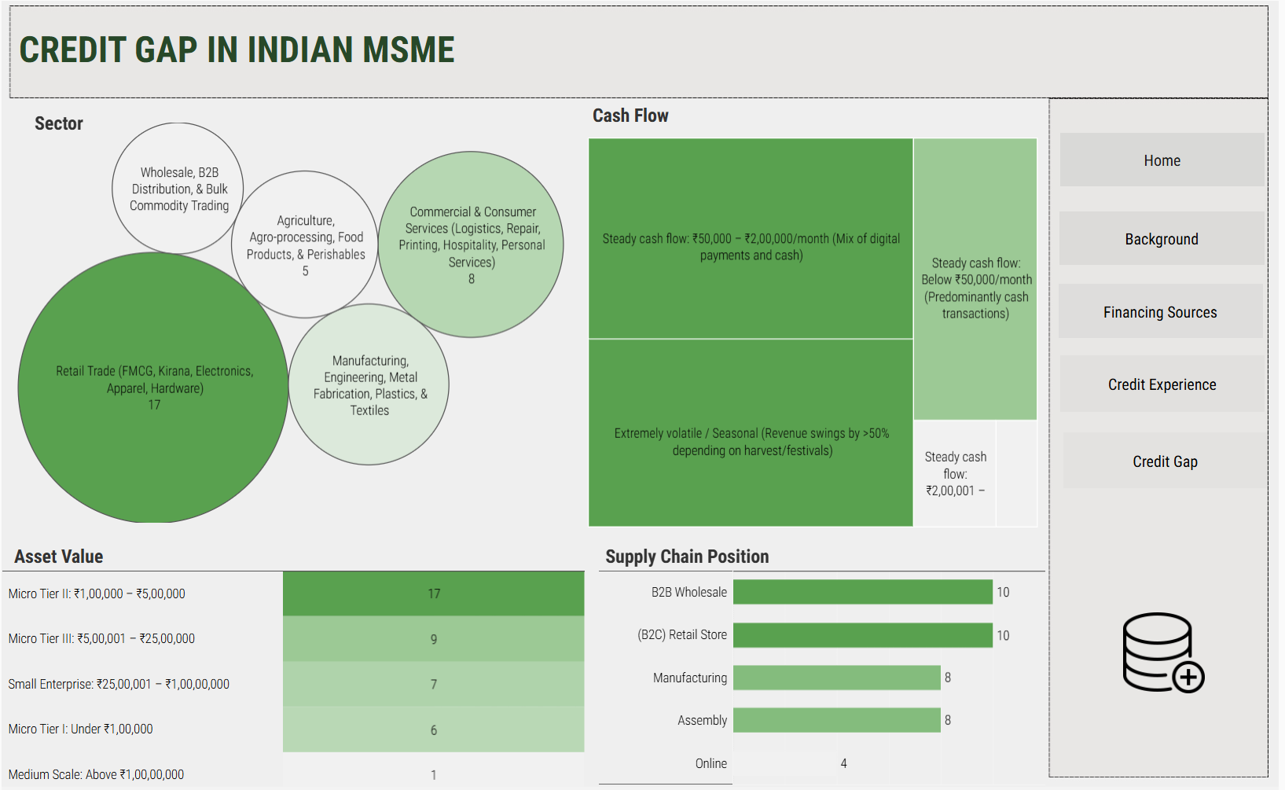
COMPANY PROFILE

Slide 10
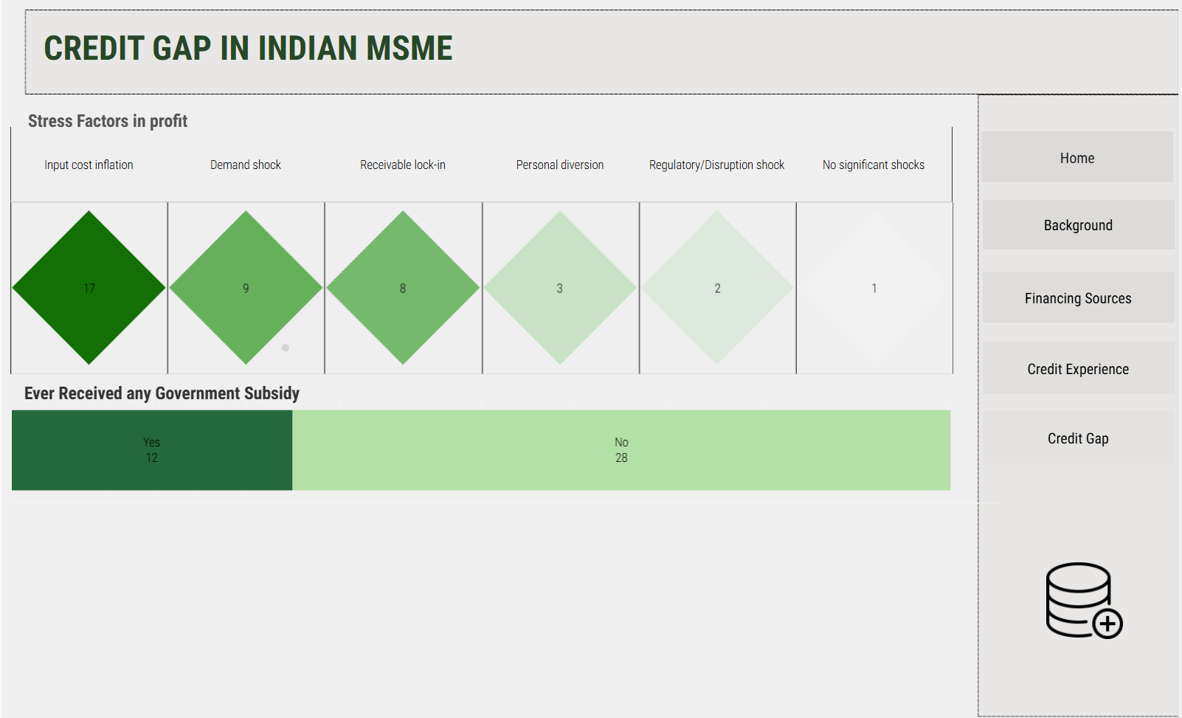
CREDIT NECESSITY

Slide 11
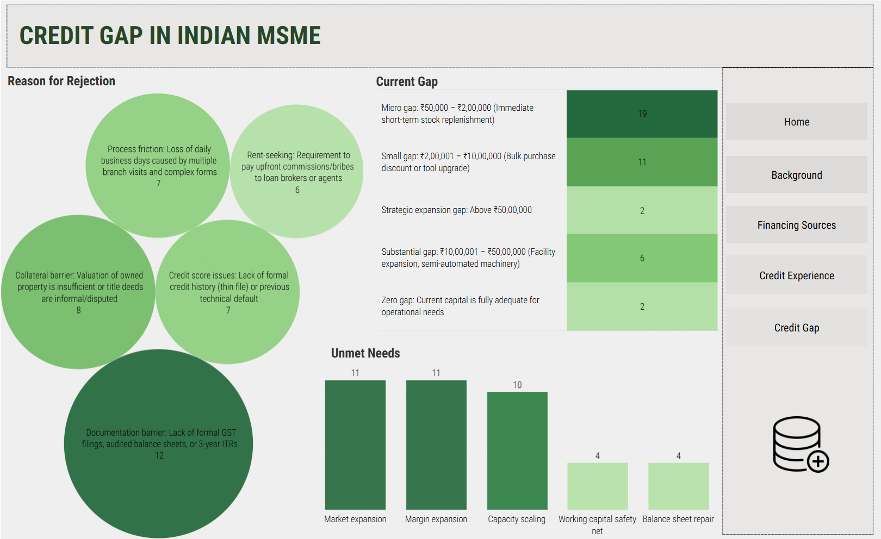
CREDIT GAP

Slide 12
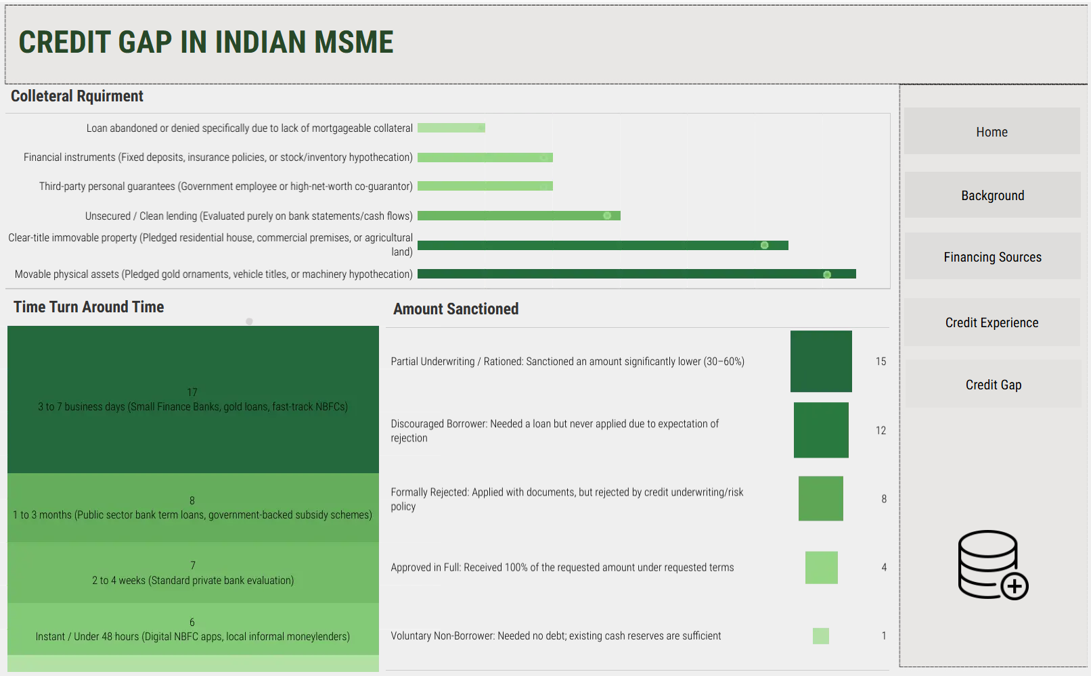
EXPERIENCE WITH CREDIT

Slide 13


RADHA KRISHNAN
Have faced difficulties in getting loans due to strict documentation requirements, lack of proper financial records, and eligibility criteria. Loan rejection can also occur because of insufficient collateral or credit history
Owner
Reponses
ANONYMOUS
“Limited access to credit can lead to missed business opportunities, difficulty in purchasing stock or equipment, delayed expansion, and cash-flow problems. It can directly affect sales, growth, and the ability to meet customer demand

